Slide 1
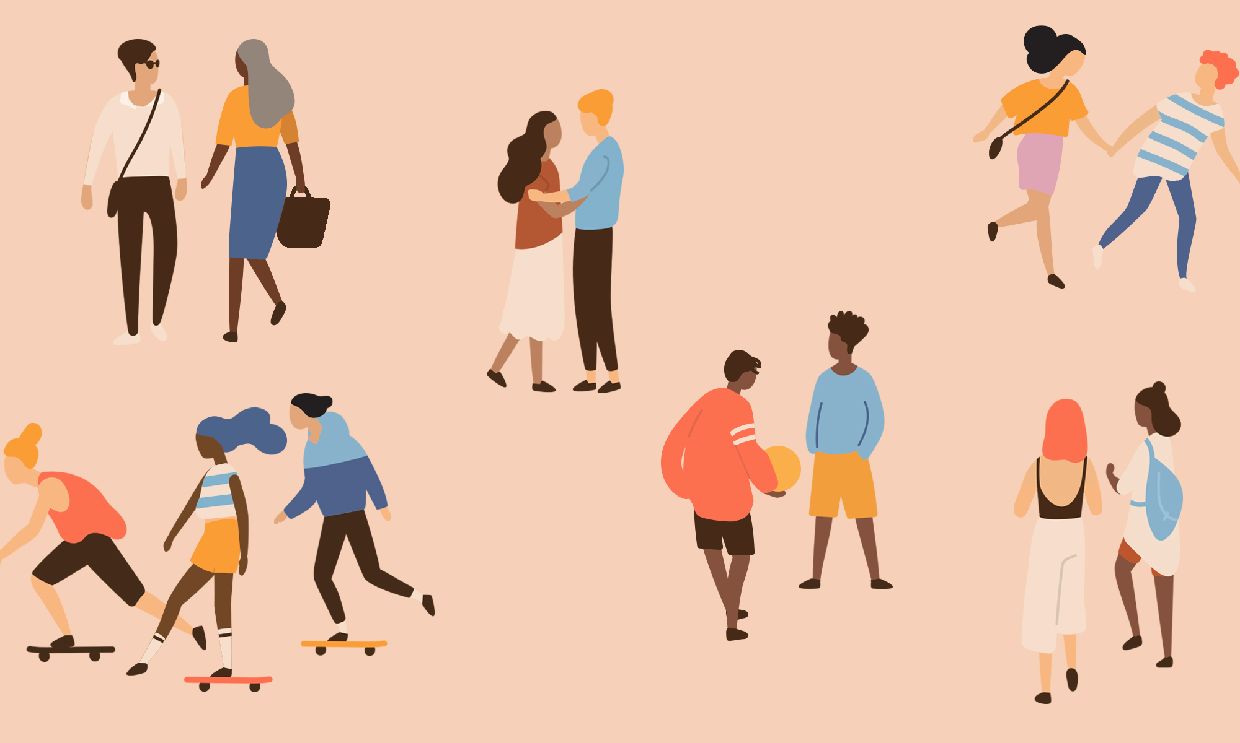
Relationships
Year 10 Health 2024
Lesson 6

Slide 2

Todays Focus:
Explore reasons young people engage in sexual behaviours.
Discuss the importance and impact of non-verbal communication.

Slide 3

Relationships and Consent
https://create.kahoot.it/share/duplicate-of-healthy-relationships/6c150074-ebb1-4d99-ad73-d7e14f9539e0
Notes:
https://create.kahoot.it/share/duplicate-of-healthy-relationships/6c150074-ebb1-4d99-ad73-d7e14f9539e0

Slide 4
Activity 1a: Pressures to be Sexually Active (pg.28)
List 5 reasons young people decide to have sexual intercourse and engage in sexual behaviours:
In love, everyone is doing it, curious, under the influence, to please someone, peer pressure, to fit in, enjoyment etc.
List 5 reasons why young people may choose to postpone sexual intercourse/sexual behaviours:
Religious/cultural reasons, don’t want to, scared, not in a relationship, past trauma, don’t know how to be safe etc.
What are some considerations that couples need to discuss prior to sex?
The risks involved, possible consequences, consent, what the desired outcome may be, how to be safe etc.
Individually answer the questions into your workbooks.
Be prepared to share your responses.

Slide 5
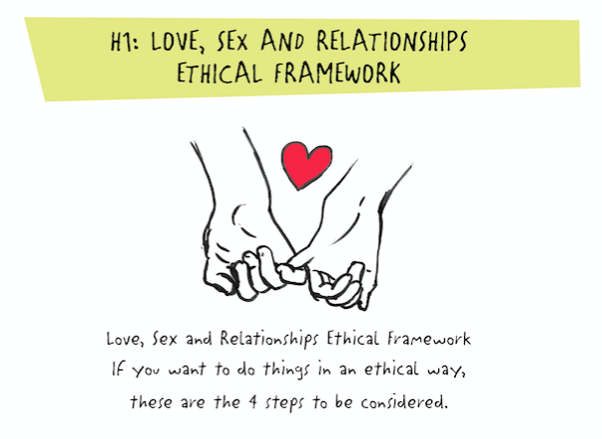
Activity 1b: Chris & Sam’s Story (pg.29)
Read the story about Chris and Sam.
Analyse the story and use the Love, Sex, and Relationships Ethical Framework to suggest what they should do and how each element of the framework applies.
Taking Care of Me
Taking Care of You
Having an Equal Say
Learning as we go

Slide 6
Taking Care of Me
Taking Care of You
Having an Equal Say
Learning As We Go
Is this what I really want to do?
Am I physically and emotionally safe?
Is the other person treating me with respect and concern?
How does what I want affect the other person?
How do I know?
Check that they’re OK with the decision.
Do we have equal power or is one person getting their way all the time?
When it comes to sex, a person owns their body & the right to control who has pleasure from it.
What would have made the situation better?
What am I doing?
What am I not doing?
What can I learn from this?
Review: Love, Sex and Relationships Ethical Framework
Notes:
Optional to review the framework

Slide 7
Chris & Sam’s Story (pg.29)
Sam has never had a boyfriend, although she has kissed a few boys. Everything changed when she met Chris at a party. He is a few years older than her and while they aren’t officially boyfriend/girlfriend (although she would like it to be), they have been with each other a few times now. She is a bit obsessed with him and can’t get him out of her mind.
There’s a party on tonight and he’s texted her a few times to see if she’ll be there. She feels both excited and nervous. She’d definitely like to be with him again, but she doesn’t want to go too far. The first time she was with him, he tried a few times to slip his hand in her jeans, but she didn’t let him. It’s got so heavy so fast, and he seems to expect a lot. She knows he’s had plenty of girlfriends and she’s flattered that he wants to be with her.
Chris is looking forward to seeing Sam tonight. She’s got this way of talking that he loves, and she is hot. He’s had quite a few girlfriends. He’s had a lot of sex. He knows she hasn’t been with many (any?) guys, but he’ll keep trying.
Chris and Sam get together at the party. They are finally alone. They are out in his car. Her shirt is off. Her jeans are down. She’s gone further than she’d planned but it was hard to stop because it felt so good. But now she wants to stop. He keeps trying for sex and she wants to stop.
Notes:
Story is also in their workbooks to follow along

Slide 8
Activity 2: Waiter-Selector Food Activity (pg.30)
Working in pairs – one person is the waiter; the other is the selector.
Selector:
In your workbook, rank the foods from 1 (most favourite) to 10 (least favourite).
You cannot speak, point or indicate anything.
You can gesture and use other non-verbal communication when answering the waiter's questions.
Waiter:
Ask the selector questions about their food choices and try and uncover their order of food order preferences.
You cannot ask questions such as “is chocolate your number 1?”
Repeat and swap roles.

Slide 9
Activity 2 Debrief: Non-Verbal Communication (pg.31)
What strategies/skills were used to convey a message?
Notes:
i.e., body language, facial expressions, noises etc.
i.e., misunderstanding, miscommunication, misinterpretation etc.
i.e., shrugging or pushing away, closed body language, grunts, negative facial expressions etc.
i.e., people may get caught up in the moment, they are only thinking about themselves and their wants/needs, false assumptions (the people may have engaged in sexual behaviours before and think that it’s okay this time, they may know the other person has engaged in those behaviours before and assume they would want too etc.)

Slide 10
Activity 2 Debrief: Non-Verbal Communication (pg.31)
What strategies/skills were used to convey a message?
Why were there/or why could there be mixed messages when communicating like this?
Notes:
i.e., body language, facial expressions, noises etc.
i.e., misunderstanding, miscommunication, misinterpretation etc.
i.e., shrugging or pushing away, closed body language, grunts, negative facial expressions etc.
i.e., people may get caught up in the moment, they are only thinking about themselves and their wants/needs, false assumptions (the people may have engaged in sexual behaviours before and think that it’s okay this time, they may know the other person has engaged in those behaviours before and assume they would want too etc.)

Slide 11
Activity 2 Debrief: Non-Verbal Communication (pg.31)
What strategies/skills were used to convey a message?
In a sexual negotiation where sexual behaviours may occur, what cues might be used if a person did not want to oblige?
Why were there/or why could there be mixed messages when communicating like this?
Notes:
i.e., body language, facial expressions, noises etc.
i.e., misunderstanding, miscommunication, misinterpretation etc.
i.e., shrugging or pushing away, closed body language, grunts, negative facial expressions etc.
i.e., people may get caught up in the moment, they are only thinking about themselves and their wants/needs, false assumptions (the people may have engaged in sexual behaviours before and think that it’s okay this time, they may know the other person has engaged in those behaviours before and assume they would want too etc.)

Slide 12
Activity 2 Debrief: Non-Verbal Communication (pg.31)
What strategies/skills were used to convey a message?
In a sexual negotiation where sexual behaviours may occur, what cues might be used if a person did not want to oblige?
Why were there/or why could there be mixed messages when communicating like this?
Why do you think there are times when people ignore the non-verbal cues, or persist even when they suspect someone is uncertain?
It is unethical and may be illegal to go ahead/continue with sex if one party is not giving consent
Notes:
i.e., body language, facial expressions, noises etc.
i.e., misunderstanding, miscommunication, misinterpretation etc.
i.e., shrugging or pushing away, closed body language, grunts, negative facial expressions etc.
i.e., people may get caught up in the moment, they are only thinking about themselves and their wants/needs, false assumptions (the people may have engaged in sexual behaviours before and think that it’s okay this time, they may know the other person has engaged in those behaviours before and assume they would want too etc.)

